Slide 1
Object Oriented Programming with Java
Day 3

Slide 2
Understanding Method Calls and Placement
Method
A program module
Contains a series of statements
Carries out a task
Execute a method
Invoke or call from another method

Slide 3
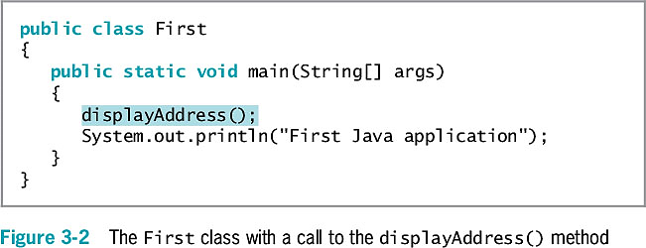
Understanding Method Calls and Placement

Slide 4
Understanding Method Calls and Placement
main() method executes automatically when the Java program is executed.
Other methods are called as needed

Slide 5
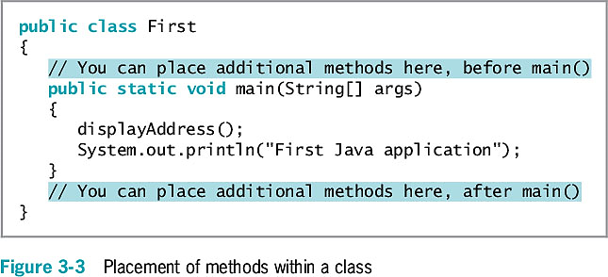
Understanding Method Calls and Placement

Slide 6
Understanding Method Construction
A method must include:
Method header
Also called a declaration
Method body
Between a pair of curly braces
Contains the statements that carry out the work
Also called implementation

Slide 7
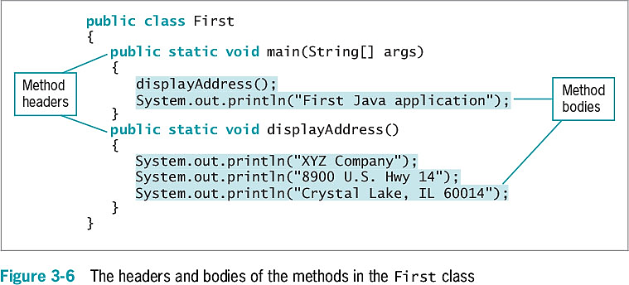
Understanding Method Construction

Slide 8
Understanding Method Construction
The method header (signature) contains:
Optional access specifiers
A return type
An identifier
Parentheses
Might contain data to be sent to the method
Place the entire method within the class that will use it
Not within any other method

Slide 9
Access Specifiers
Can be public, private, protected , or package
public access allows use by any other class
private method can be accessed by within the container class, but cannot be accessed by other classes/programs.
protected method can be accessed within the container class and any subclasses (more on this later)
package (or default) method can be accessed within the container class and any other class in the same package.
Also called access modifiers

Slide 10
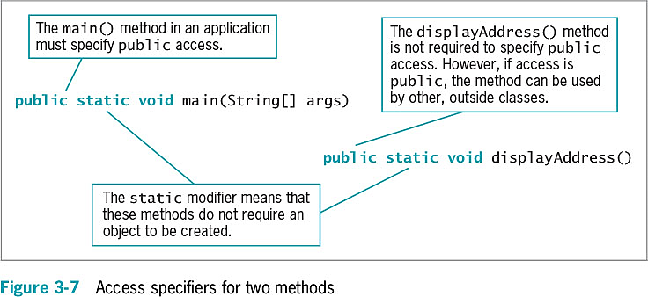
Access Specifiers

Slide 11
Return Type
Describes the type of data the method sends back to the calling method
If no data is returned to the method, the return value is void

Slide 12
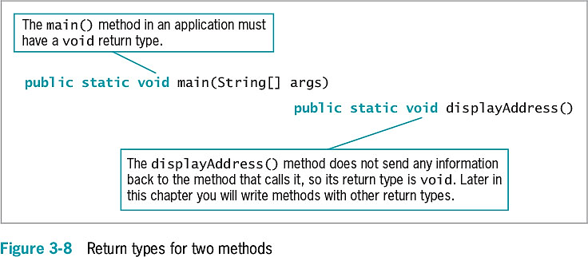
Return Type

Slide 13
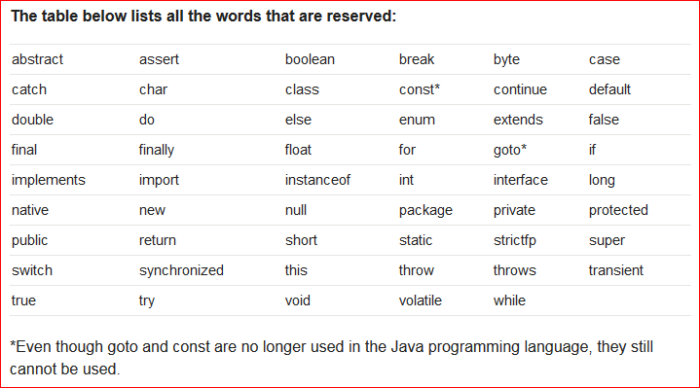
Method Name
Can be any legal identifier
Must be one word
No embedded spaces
Cannot be a Java keyword
http://java.about.com/od/javasyntax/a/reservedwords.htm

Slide 14
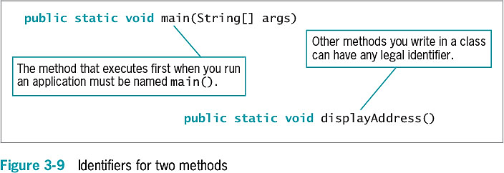
Method Name

Slide 15
Parentheses
Every method header contains a set of parentheses that follow the identifier
May contain data to be sent to the method
Fully qualified identifier
A complete name that includes the class

Slide 16
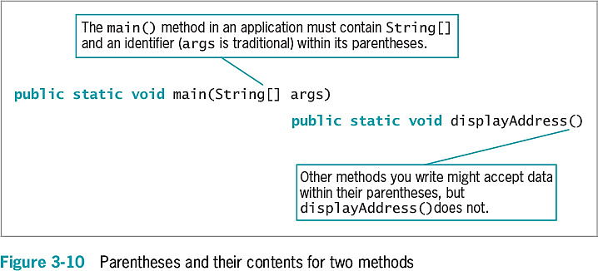
Parentheses

Slide 17
Adding Parameters to Methods
Arguments
Data items you use in a call to a method
Parameters
Data items received by the method
Implementation hiding
Encapsulation of method details within a class
The calling method needs to understand only the interface to the called method
Interface
The only part of a method that the client sees or with which it interacts

Slide 18
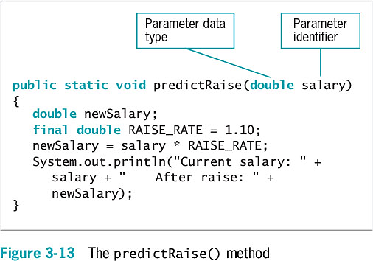
Example of a Method That Receives a Single Parameter

Slide 19
Local Variables
Local variable
Known only within the boundaries of the method
Each time the method executes:
The variable is redeclared
A new memory location large enough to hold the type is set up and named

Slide 20
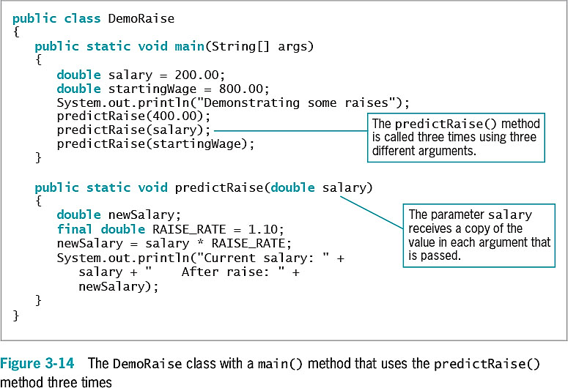
Local Variables

Slide 21
Creating a Method That Requires Multiple Parameters
A method can require more than one parameter
List the arguments within the call to the method
Separate with commas
Call a method
Arguments sent to the method must match the parameters listed in the method declaration by:
Number
Type

Slide 22
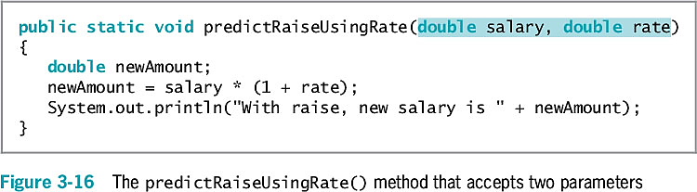
Example of a Method That Requires Multiple Parameters

Slide 23
Creating Methods That Return Values
return statement
Causes a value to be sent from the called method back to the calling method
The return type can be any type used in Java
Primitive types
Class types
void
Returns nothing
Method’s type
A method’s return type

Slide 24
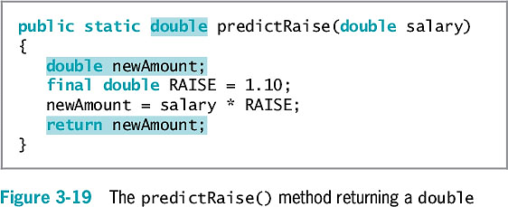
Creating Methods That Return Values

Slide 25
Creating Methods That Return Values
Unreachable statements (dead code)
Logical flow leaves the method at the return statement
Can never execute
Causes a compiler error

Slide 26
Chaining Method Calls
Any method might call any number of other methods
Method acts as a black box
Do not need to know how it works
Just call and use the result

Slide 27
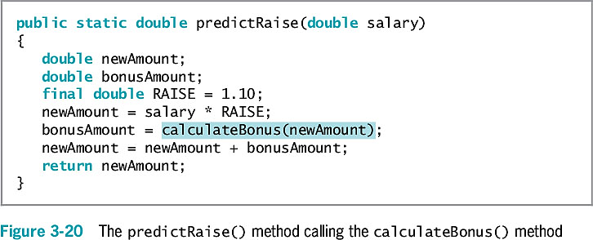
Chaining Method Calls

Slide 28
Exercise
Create a program that calculates the commission from selling a car.
The program should prompt for two input parameters (use the Scanner object): car model and price
Declare a commission rate of 5%
The program should output the commission value based on the input. Sample output:
The sale commission from Jetta is $1000.

Slide 29
Learning About Classes and Objects
Every object is a member of a class
Is-a relationships
An object “is a” concrete example of the class
The zoo’s shark “is a” Fish
Instantiation
Shark is an instantiation of the Fish class
Reusability

Slide 30
Learning About Classes and Objects
Methods are often called upon to return a piece of information to the source of the request
Class client or class user
An application or a class that instantiates objects of another prewritten class

Slide 31
Creating a Class
Assign a name to the class
Determine what data and methods will be part of the class
Create a class header with three parts:
An optional access modifier
The keyword class
Any legal identifier for the name of the class
public class
Accessible by all objects

Slide 32
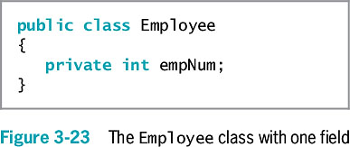
Creating a Class

Slide 33
Creating a Class
Extended
To be used as a basis for any other class
Data fields
Variables declared within a class but outside of any method
Instance variables
Nonstatic fields given to each object

Slide 34
Creating a Class
Private access for fields
No other classes can access the field’s values
Only methods of the same class are allowed to use private variables
Information hiding (Encapsulation)
Most class methods are public

Slide 35
Creating Instance Methods in a Class
Classes contain methods
Mutator methods
Set or change field values
Accessor methods
Retrieve values
Nonstatic methods
Instance methods
“Belong” to objects
Typically declare nonstatic data fields
static class variables are not instance variables

Slide 36
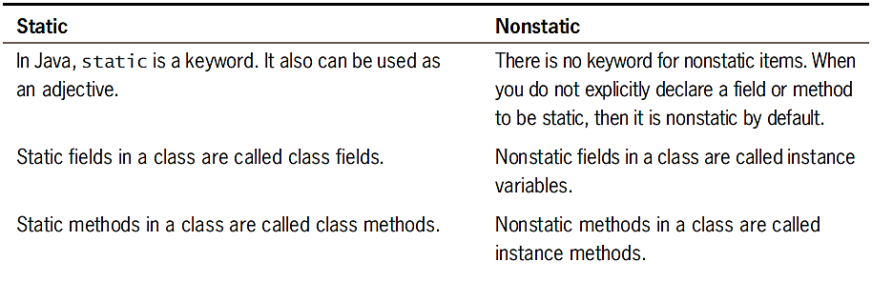
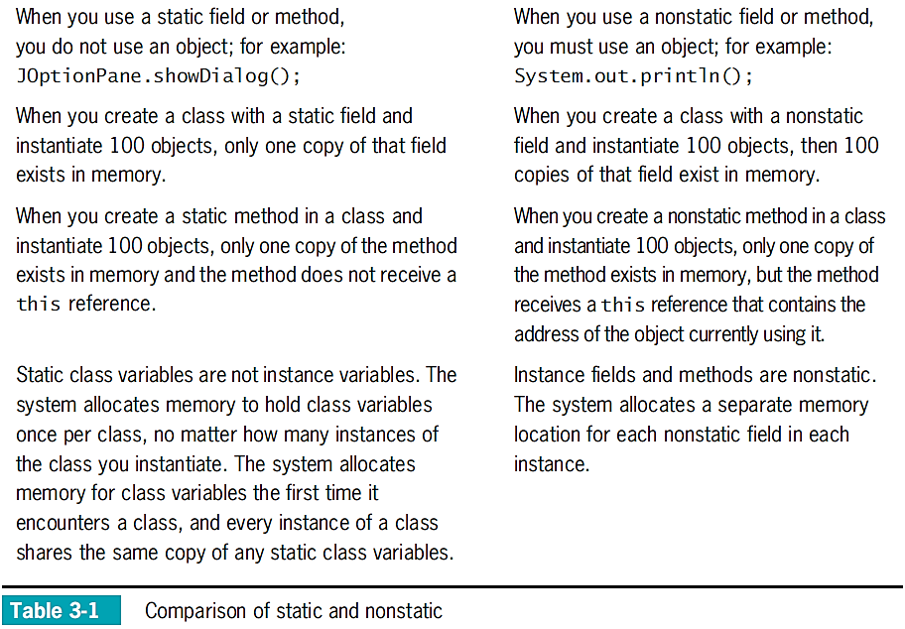

Slide 37
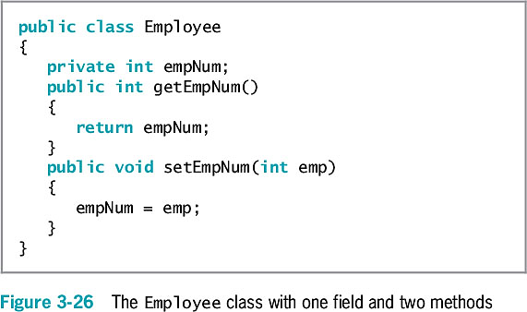
Creating Instance Methods in a Class
Getters and setters guarantee that the primitive variables are passed by value, not by reference.
Notes:
Explain the difference between passing by reference and by value.

Slide 38
Organizing Classes
Place data fields in logical order
At the beginning of a class
List the fields vertically
Data fields and methods may be placed in any order within a class
It’s common to list all data fields first
Names and data types can be seen before reading the methods that use the data fields

Slide 39
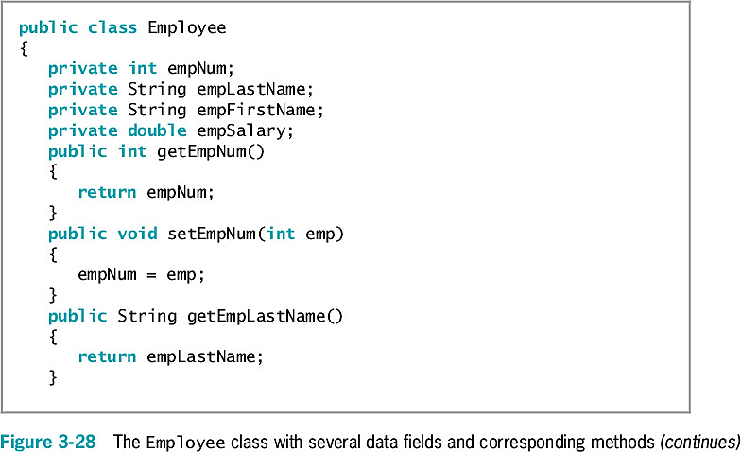
Organizing Classes

Slide 40
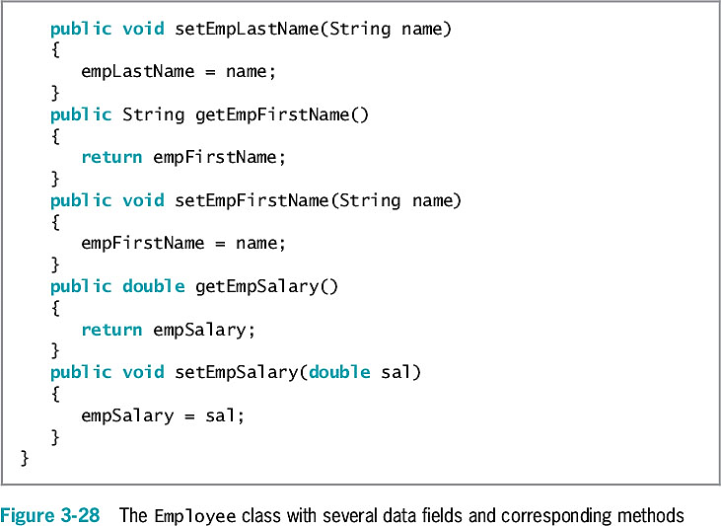
Organizing Classes
(continued)

Slide 41
Declaring Objects and Using Their Methods
Declaring a class does not create any actual objects
To create an instance of a class:
Supply a type and an identifier
Allocate computer memory for the object
Use the new operator
Employee someEmployee;
someEmployee = new Employee();
or
Employee someEmployee = new Employee();

Slide 42
Declaring Objects and Using Their Methods
Reference to the object
The name for a memory address where the object is held (someEmployee)
Constructor method
A method that creates and initializes class objects
You can write your own constructor methods
Java uses a default constructor when you don’t write one
The name of the constructor is always the same as the name of the class whose objects it constructs

Slide 43
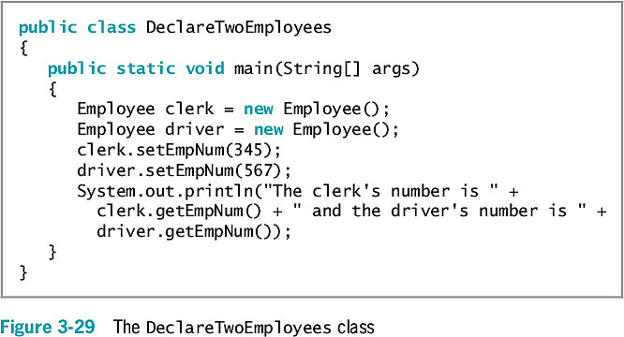
Declaring Objects and Using Their Methods
After an object is instantiated, its methods can be accessed using:
The object’s identifier
A dot
A method call

Slide 44
Understanding Data Hiding
Data hiding using encapsulation
Data fields are usually private
The client application accesses them only through public interfaces
set method
Controls the data values used to set a variable
get method
Controls how a value is retrieved

Slide 45
An Introduction to Using Constructors
Employee chauffeur = new Employee();
Actually a calling method named Employee()
Default constructors
Require no arguments
Created automatically by a Java compiler
For any class
Whenever you do not write a constructor

Slide 46
An Introduction to Using Constructors
The default constructor provides specific initial values to an object’s data fields
Numeric fields
Set to 0 (zero)
Character fields
Set to Unicode ‘\u0000’
Boolean fields
Set to false
Nonprimitive object fields
Set to null

Slide 47
An Introduction to Using Constructors
A constructor method:
Must have the same name as the class it constructs
Cannot have a return type
public access modifier

Slide 48
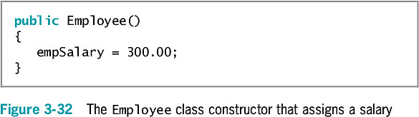
An Introduction to Using Constructors

Slide 49
Understanding That Classes Are Data Types
Classes you create become data types
Often referred to as abstract data types (ADTs)
Implementation is hidden and accessed through public methods
Programmer-defined data type
Not built into the language

Slide 50
Don’t Do It
Don’t create a class method that has a parameter with the same identifier as a class field
Explain why

Slide 51
Summary
Method
A series of statements that carry out a task
A declaration includes the parameter type and local name for a parameter
You can pass multiple arguments to methods
Has a return type
Class objects
Have attributes and methods associated with them
Instantiate objects that are members of a class

Slide 52
Summary
Constructor
A method establishes an object and provides specific initial values for an object’s data fields
Everything is an object
Every object is a member of a more general class
Implementation hiding, or encapsulation
private data fields
public access methods

Slide 53
Exercise
There are 2.54 centimeters in an inch, and there are 3.7854 liters in a US gallon. Create a class named MetricConversion. Its main() method accepts an integer value from a user at the keyboard, and in turn passes the entered value to two methods. One converts the value from inches to centimeters and the other converts the same value from gallons to Liters. Each method displays the results with appropriate explanation.

